Slide 1




Journey to Secure Agility: How Saxo Bank Embraced DevSecOps in the Era of Containers and Kubernetes
Jinhong Brejnholt
Saxo Bank
jbrejnholt

Slide 2
abstract
Notes – To be removed later!
Embark on an inspiring journey with Saxo Bank as we unveil our transformation in the ever-evolving landscape of software development. In this captivating storytelling session, we will share our experience of adopting containers and Kubernetes, and how we navigated the challenges to build a robust and collaborative DevSecOps culture. Join us as we rewind the clock and dive into the early days of our containerization journey. We will shed light on the pivotal moments, the hurdles we faced, and the valuable lessons we learned along the way. From the promise of scalability and flexibility that containers and Kubernetes offered, we will reveal the challenges that emerged with the increased complexity of our technology stack. Through this narrative, we will explore the collaboration hurdles encountered between development, security, and operations teams. We will delve into the inherent silos and communication gaps that hindered our progress, creating bottlenecks in our DevSecOps initiatives. However, this story doesn't end in despair; it is a testament to our determination to evolve and thrive. Discover how we overcame these challenges by prioritizing collaboration and aligning our goals. We will share the strategies and practical steps we took to foster effective cross-team communication and shared responsibility. From breaking down silos to establishing open feedback channels, we will reveal the key ingredients for successful collaboration in a containerized environment. Moreover, we will delve into the transformational power of DevSecOps and how it revolutionized our approach to security. By integrating security practices throughout the development lifecycle, we improved our ability to detect vulnerabilities and mitigate risks. We will discuss the automated security checks and tools we implemented to ensure timely and proactive feedback for developers, allowing them to embrace security as an integral part of their work.

Slide 3

Agenda
Who we are
Our current setup
How we got there
Share learnings

Slide 4




Slide 5

jbrejnholt
Notes:
“Saxo Bank is a very different bank, and we want our environment to reflect that. The T-Rex that hangs in the canteen reminds us that we need to remain agile and be on the leading edge of technology developments so that we can continue to help our clients and partners navigate the global markets. In other words, we cannot become dinosaurs.” --Kim Fournais, CEO and Founder, Saxo Bank
Saxo Bank is a Danish investment bank specializing in online trading and investment. It was founded as a brokerage firm in 1992, under the name Midas Fondsmæglerselskab, by Lars Seier Christensen, Kim Fournais, and Marc Hauschildt. The name was changed to Saxo when the company obtained a banking license in 2001.
Saxo Bank A/S is a fully licensed and regulated Danish bank with an online trading platform that empowers you to invest across global financial markets.

Slide 6

Our Setup
~ 25 clusters (+ number of DCs) and growing
Between 10 to 50 nodes
Around 500 deployments per day
Hybrid Cloud

Slide 7

The Good Old Days
Notes:
We have streamlined our process of releasing software to on-prem datacenters
There are (sometimes) up to 90% compute waste in servers – but who is counting ☺

Slide 8

Then Cloud Computing Happened
Notes:
Discuss the motivation behind adopting containers and Kubernetes.
Highlight the promises of scalability and flexibility that these technologies offered.
Mention the initial challenges faced during the transition.

Slide 9


Slide 10

We thought we have figured out everything

Slide 11


Challenges and Hurdles
Legacy Code and Process

Slide 12

Too Many Windows!

Slide 13

Challenges and Hurdles
Legacy Code and Process
Culture Conflict

Slide 14
New Acquisition Culture Conflict

Slide 15

Challenges and Hurdles
Legacy Code and Process
Culture Conflict
Forced Collaboration

Slide 16

Forced Collaboration
Notes:
No longer enough to talk to infrastructure/security teams once per year
Need to rework

Slide 17

Challenges and Hurdles
Legacy Code and Process
Culture Conflict
Forced Collaboration
Complex tech stack

Slide 18
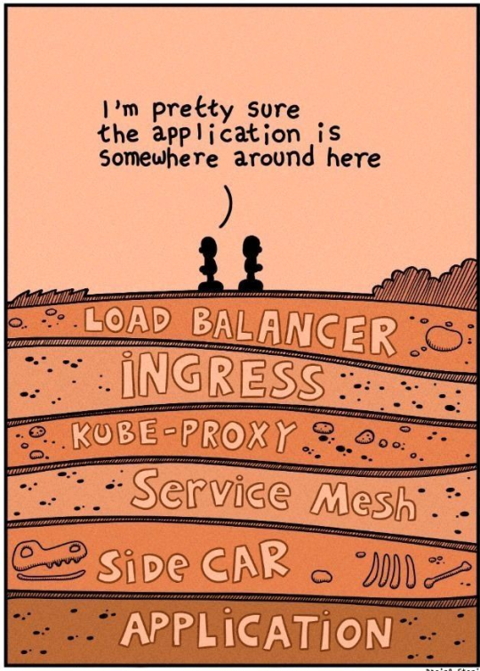
Complex tech stack
Notes:
From developerElaborate on the complexities that emerged with the increased technology stack.
Discuss the collaboration hurdles encountered between development, security, and operations teams.
Explain how these challenges created bottlenecks in DevSecOps initiatives.

Slide 19
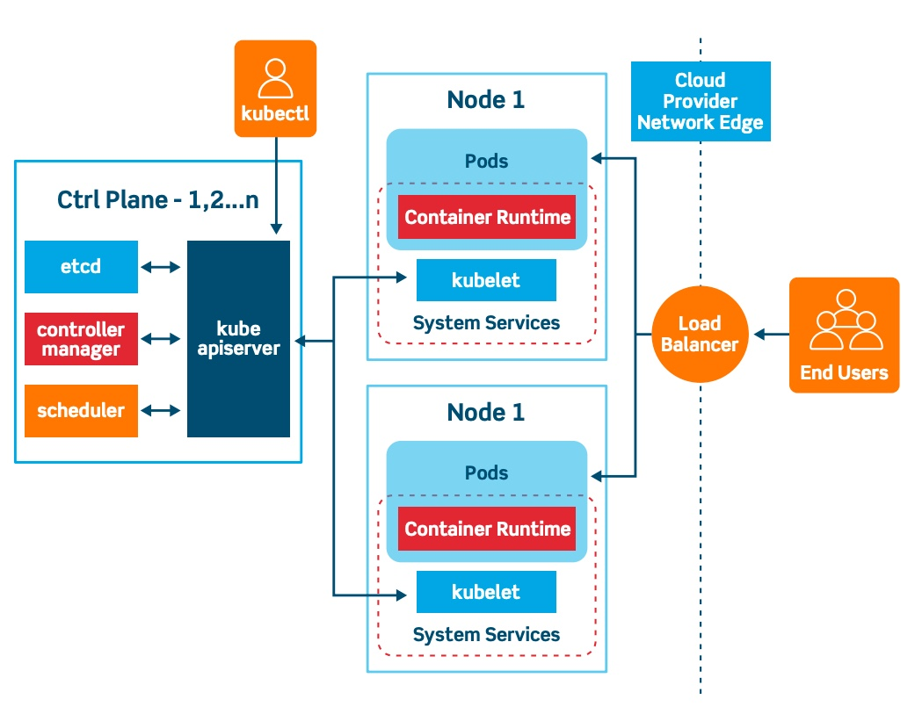
Complex tech stack
Notes:
From DevOps/Platform Engineers

Slide 20
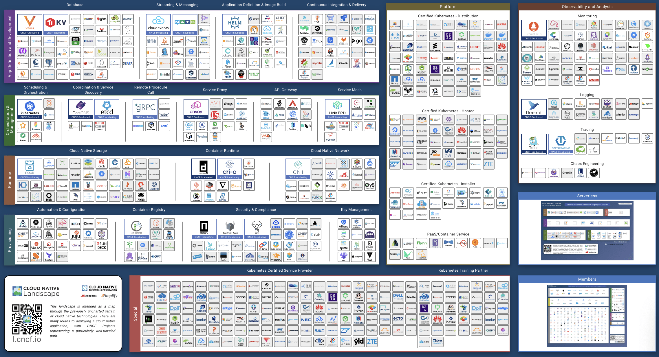
Notes:
IF that wasn’t bad enough

Slide 21

We Have To Adopt
Notes:
Emphasize Saxo Bank's determination to overcome the challenges.
Highlight the importance of adapting to changing circumstances and embracing innovation.

Slide 22

1. Aligning Goals for Success
Notes:
Discuss the importance of aligning the goals of development, security, and operations teams.
Highlight the benefits of shared responsibility.

Slide 23

2. Cross-Team Collaboration
Notes:
Share the strategies implemented to prioritize collaboration.
Discuss how communication gaps and silos were broken down.
Mention the establishment of open feedback channels.

Slide 24



3. Shift left, shield right
Notes:
Explain the concept of DevSecOps and its significance in modern software development.
Discuss how DevSecOps revolutionized Saxo Bank's approach to security.

Slide 25

DevSecOps
IDE Clean Code Integration
Cli Scanning
Private artifact registry
1
Static Code Analysis
Test Coverage
CVE scanning
License scanning
2
Image signing
Private container registry
Lightweight change process
3
Runtime CVE scanning
Security Policies enforcement
Best Practice Policies Enforcement
Application Monitoring
4
Behavior
Resource consumption
Performance
Notes:
Get feedback fast

Slide 26
DevSecOps
IDE Clean Code Integration
Cli Scanning
Private artifact registry
1
Static Code Analysis
Test Coverage
CVE scanning
License scanning
2
Image signing
Private container registry
Lightweight change process
3
Runtime CVE scanning
Security Policies enforcement
Best Practice Policies Enforcement
Application Monitoring
4
Behavior
Performance
Resource consumption
Notes:
Automated Security Checks and Tools – offer pipeline steps for quality code

Slide 27
DevSecOps
IDE Clean Code Integration
Cli Scanning
Private artifact registry
1
Static Code Analysis
Test Coverage
CVE scanning
License scanning
2
Image signing
Private container registry
Lightweight change process
3
Runtime CVE scanning
Security Policies enforcement
Best Practice Policies Enforcement
Application Monitoring
4
Behavior
Performance
Resource consumption
Notes:
Pipeline steps, hardened base images, compliant
No more length cab process

Slide 28
DevSecOps
IDE Clean Code Integration
Cli Scanning
Private artifact registry
1
Static Code Analysis
Test Coverage
CVE scanning
License scanning
2
Image signing
Private container registry
Lightweight change process
3
Runtime CVE scanning
Security Policies enforcement
Best Practice Policies Enforcement
Application Monitoring
4
Behavior
Performance
Resource consumption
Notes:
Stay secure by adopting base helm chart, example dashboard and trainings

Slide 29

Look Ahead
Continue conquering the remaining 90%
Go hybrid and cross-region
GitOps the outside world
More alignment & communication
Continue improving for better DevEx

Slide 30

Thank You
Notes:
Stockholm

Slide 31

Thank You
Notes:
CPH

